Slide 1
PUSL 2026 - Computer Networks
Lecture 8 – Segmentations & Network Topologies
Chamara Disanayake
Senior Lecturer
Department of Network and Security

Slide 2
Why an Address?
Everyone must be uniquely identifiable ( E.g. Name /ID numbers/passport numbers/social security /Student ID no /exam index).
The names are easy to remember for us.
Why we need different identifiers?
Network nodes needs to be identified uniquely for reliable communication.
The numbers are easy for computers especially binary, but difficult for humans.
Binary can be easily handling by logic gates ( AND/ OR/ XOR/ NAND).
There are different addressing methods used for data communication
They are used in different formats, in different conditions and by different layers

Slide 3
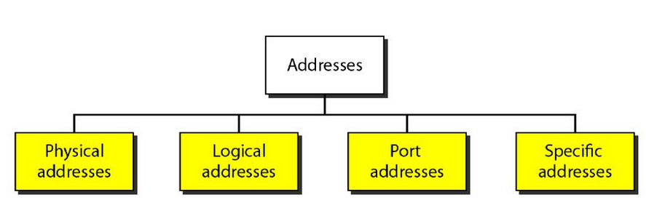
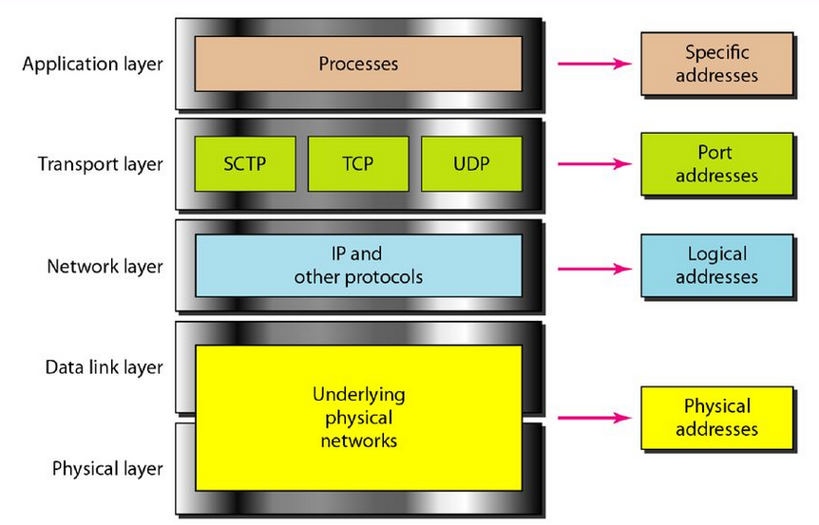
Unique Communication
Identify each other
Addressing methods
Each address method is used in different layers
chamara.d@nsbm.ac.lk
Localhost:8080
52.21.238.111
c4-a4-02-ef-50-b5

Slide 4
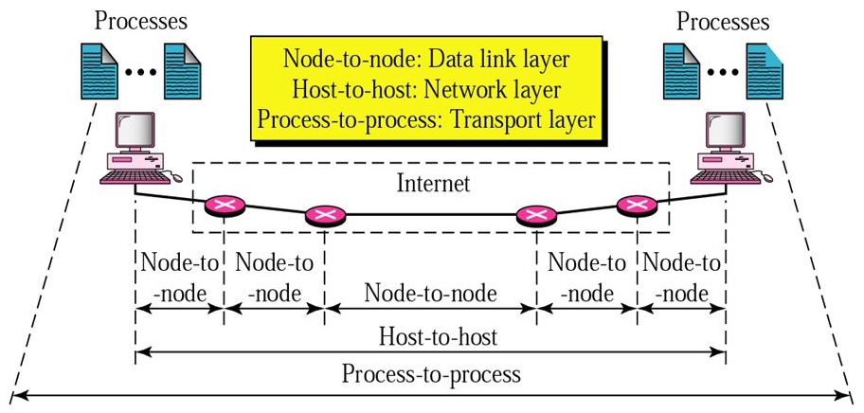
How these Addresses are Used
Data link layer – MAC addressing
Network layer – IP addressing (IPv4/IPv6 with domain specific addressing for human readability)
E.g www.nsbm.ac.lk ←→ 52.21.238.111
Transport layer – Port addressing

Slide 5
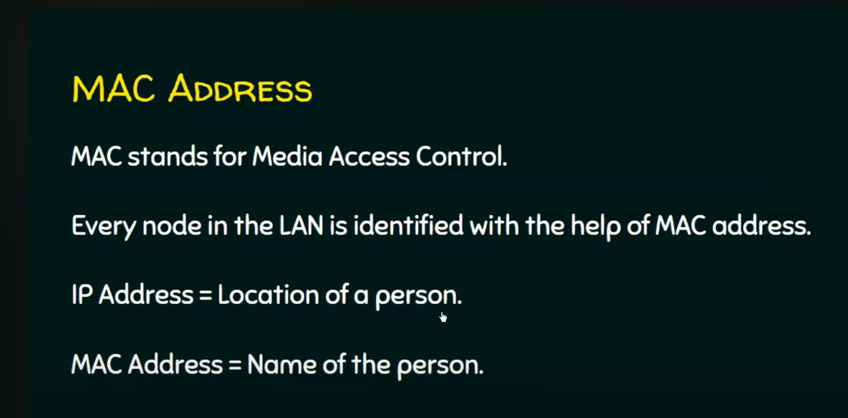
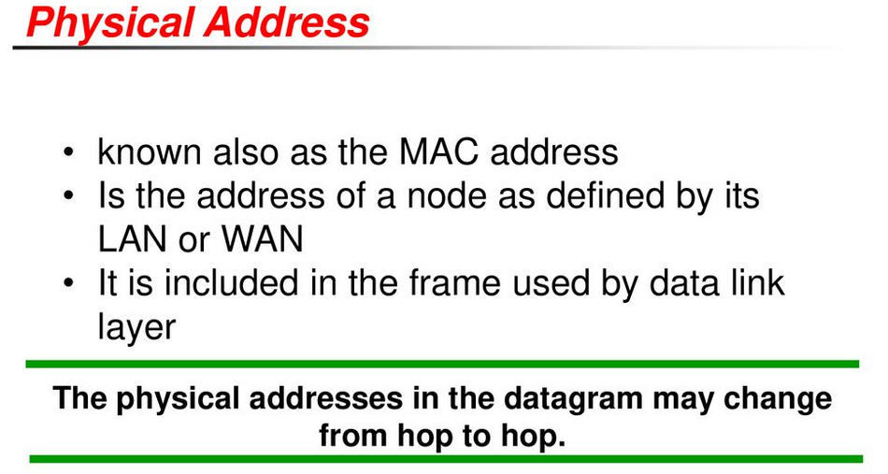
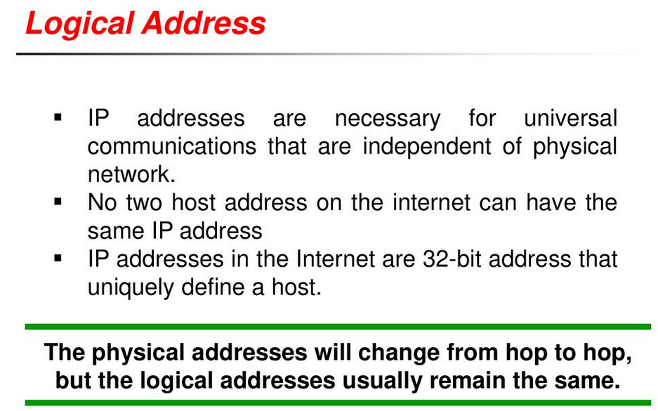
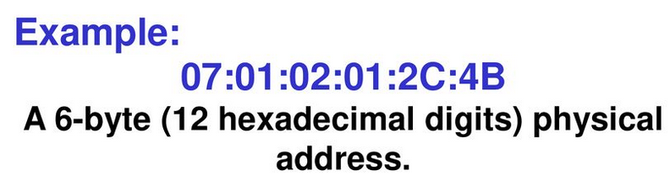
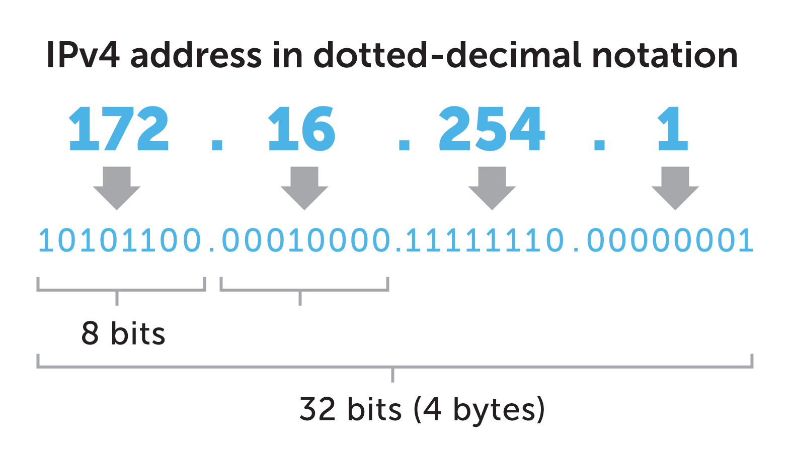
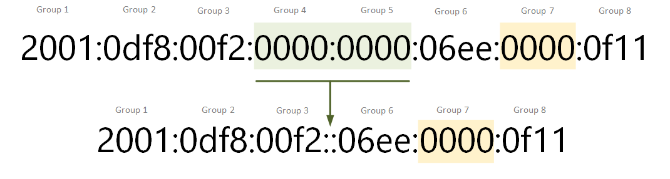

Addressing Formats
Each layer use their specific addressing in directing the communication between the end points.
Two Versions used
IPv4
IPv6

Slide 6
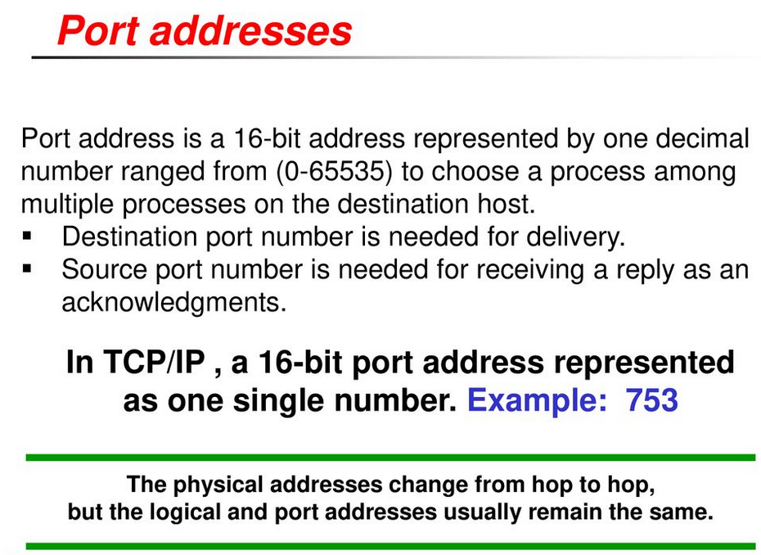
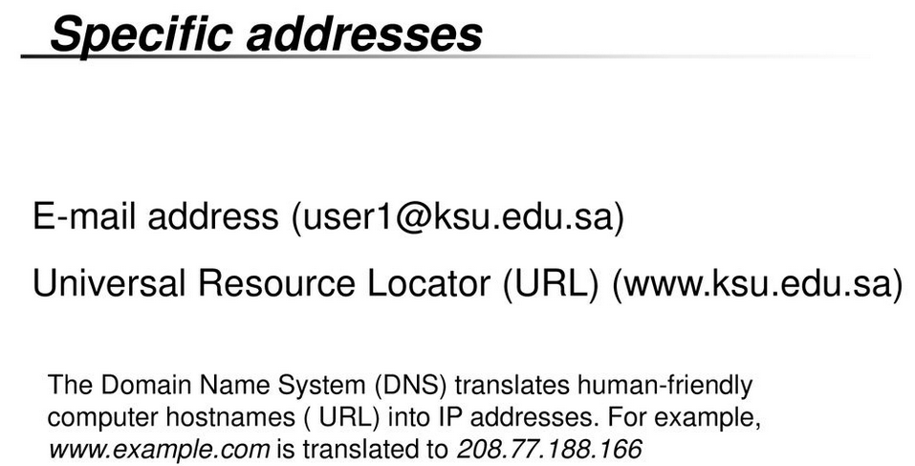
Addressing
Port Addresses and Specific Addresses

Slide 7
IPv4 Address Schema
Internet Protocol version 4 (IPv4) is the fourth version of the Internet Protocol (IP).
IPv4 uses 32-bit addresses which limits the address space to 4294967296 (232) addresses.
IPv4 was the first version deployed for production on SATNET in 1982 and on the ARPANET in January 1983.
It is still used to route most Internet traffic today – Over 60%
IPv4 is a connectionless protocol, and operates on a best-effort delivery model, in that it does not guarantee delivery, nor does it assure proper sequencing or avoidance of duplicate delivery.

Slide 8
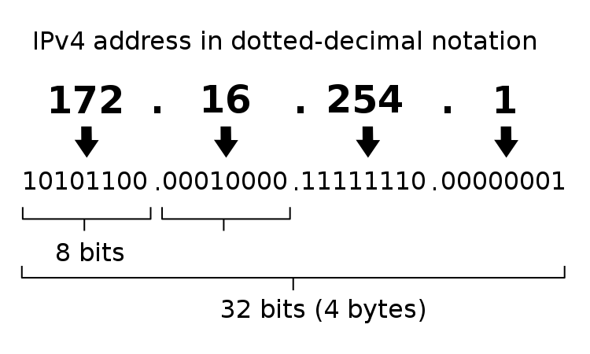
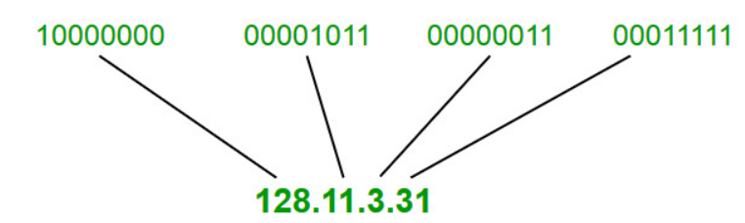
IPv4 Addressing
A binary number with 32 bits (4 Byte)
Typically written in decimal digits, formatted as four 8-bit fields that are separated by periods ‘.’
Each of the four numbers can range from 0 to 255.
Why?
What is the first address of IPv4?
What is the last IP of IPv4?

Slide 9
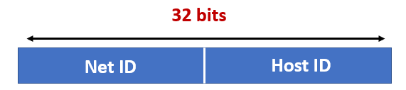
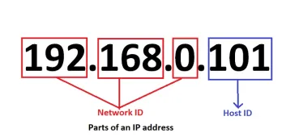
Parts of an IP Address
An IP address made up of two components, a network portion and a host portion.
The network address is used to identify the network and is common to all the devices attached to the network.
The host (or node) address is used to identify a particular device attached to the network.

Slide 10
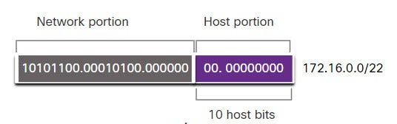

IP Address Notation - Prefix
IP Addresses are assigned to networks.
Network Administrators should define the network portion of the address.
They must define the number of bits for Network
Notation to denote the number of bits for network portion is as below.
192.248.8.32/27
This ‘/’ notation is defined as the ‘Prefix’ of the network

Slide 11
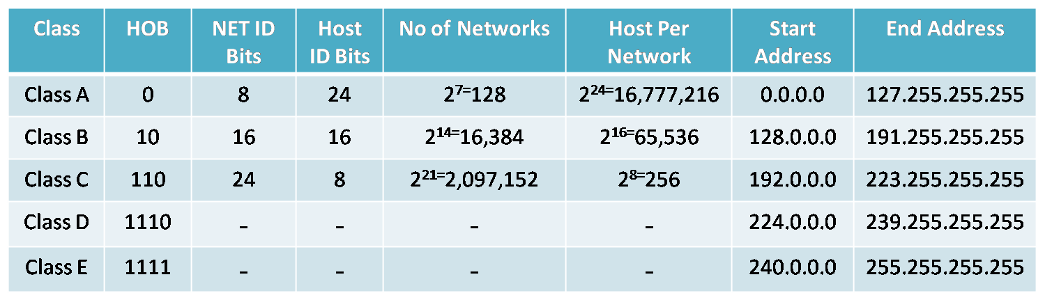
IPv4 Address Classes
Used in earlier network address assigning processes.
It divides addresses into five groups.
Address classes are defined according to “First Octet Rule”
For Nodes
For Multicasting
For Future Use

Slide 12
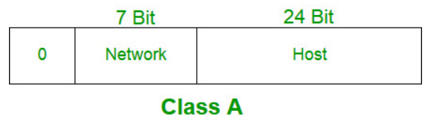
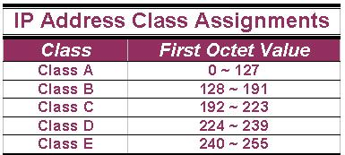
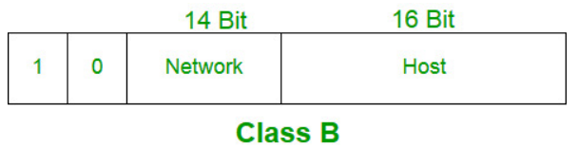
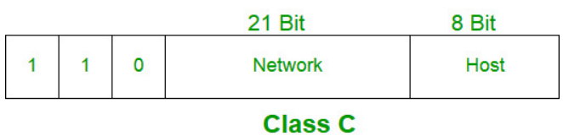
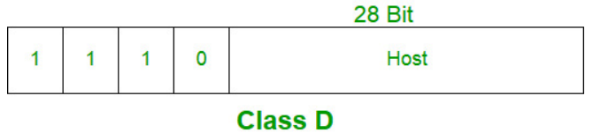
IP Address Classes
Reserve space for Private Addressing
10.0.0.0/8
172.16.0.0/12
192.168.0.0/16

Slide 13
Limitations of Classful Addressing
Addresses were being wasted in too-large blocks, and it was clear there’d be a tipping point where we ran out of IP address space altogether.
One of the best ways to understand why this was a problem is to consider an organization that needed a network just slightly bigger than a Class C.
For example, suppose our example organization needs 500 IP addresses. Going up to a Class B network means wasting 65,034 addresses (65,534 usable Class B host addresses minus 500).
Similarly, if it needed just 2 public IP addresses, a Class C would waste 252 (254 usable addresses – 2).

Slide 14
Classless Addressing
Classless addressing is an IPv4 addressing architecture that uses variable-length subnet masking.
The solution would come in 1993, as Classless Inter-Domain Routing (CIDR) introducing the concept of classless addressing.
Classless addressing, decouples IP address ranges from a default subnet mask, allowing for variable-length subnet masking (VLSM).
Using classless addressing and VLSM, addresses can be allocated much more efficiently.
This is because network admins get to pick network masks, and in turn, blocks of IP addresses that are the right size for any purpose.

Slide 15
Subnetting
Creating Smaller Networks on Request

Slide 16
The Requirement for Breakdown of Network - Subnetting
Our requirements of networks differs form individuals/ applications / geography/ time/ etc..
They require different level of service delivery /Quality /availability/ operation and Management controls/ security /etc
When number of devices are large its difficult to manage.
Best is “Divided and Conquer”.
Needs to control the shouting ( broadcast ) in the network.
Subnetting is the way of deriving the network in to sub networks according to the requirement

Slide 17
Subnet and Notation
Notation which used to Identify the IP subnets in CIDR
E.g. Subnet of 192.248.8.0/24
/24 is defined as the prefix
This means the number of bits allocated for the network
We can calculate the host bits
32-24 = 8 bits
hosts bits defines the number of IP addresses in the subnet.
In /24 subnet, 32-24=8 is the host bits → 2^8=256 IP addresses are derived from /24

Slide 18
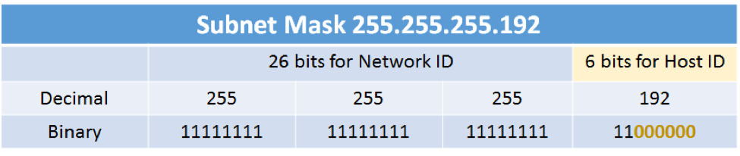
Address Masks / Subnet Mask
The address subnet mask has ones (‘1’) in positions corresponding to the network and subnet numbers and zeros (‘0’) in the host number positions.
Eg:
172.21.0.0 is a Class B address, the last 2 octets make up the host bits.
Each device or interface will be assigned a unique, host-specific address such as 172.21.35.17
The subnet mask is 11111111 11111111 00000000 00000000
Which derives → 255.255.0.0
E.g. If the host bits are 6 what is the derive the subnet mask

Slide 19


Addresses in a Subnet
If we know the number of bits allocated to host part, we can derive the number of IP addresses in the network – Already discussed
E.g. In a /26 network, host bits =32-26=6→ Number of IP addresses=2^6→ 64
Subnet mask= 11111111 11111111 11111111 11000000
In any network (or subnet) we can not use all the IP addresses we derived to assign to the hosts/nodes.
We lose two addresses for every network or subnet.
Network Address - One address is reserved to that of the network. This address can not be assigned to an interface
Broadcast Address – One address is reserved to address all hosts in that network or subnet. This address can not be assigned to an interface.

Slide 20
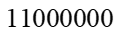
Network Address
If the prefix is given for an IP address, it is simple to derive the subnet mask and hence the network IP address.
How?
Network Address is the starting address( 1st Address) of the given IP network.
It can be derived with AND operation
For each bit of the IPv4 address, performs a Boolean (logical) AND function with the corresponding bit of the subnet mask, which is a 32-bit string to derive the network address.
Example Given IP 138.101.114.250/26
AND

Slide 21
Exercise
IP address and a prefix is given as 192.168.2.17/28
How many IP addresses available in the subnet
What is the netmask?
What is the Network Address
What is the broadcast IP
What can be used as the gateway

Slide 22
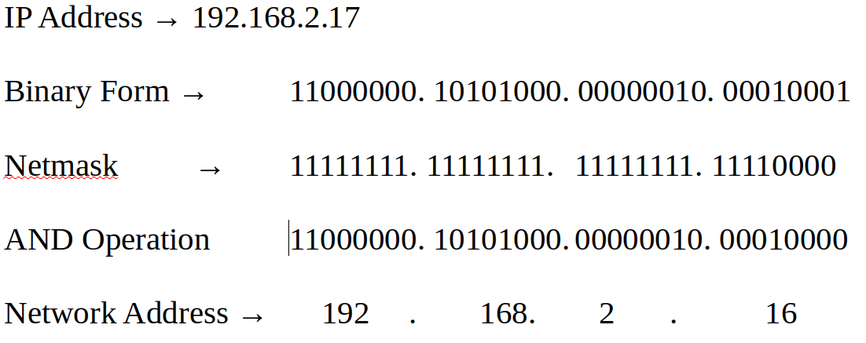
Answer
/28 is the network bits → 32-28 → 4 bits for host → 2^4 → 16 hosts can be allocated
Netmask
11111111.11111111.11111111.11110000
Network Address

Slide 23
Subnet Sizes
It is the process of defining the required sub network according to the network nodes requirement in the network.
In CIDR, subnets are changes in the numbers which in power of 2
Subnets are defined in 2^{x} sizes
1,2,4,8,16,32,64,128
X is the host bits → Prefix is 32-X
For example, when you need a network to cater 14 hosts, you need to have the subnet with 16 nodes
Then X = 4
Host bits = 4 → Prefix is 32-4 = 28
Network is 192.248.8.0/28 (Example)

Slide 24
Exam Question
Question 4
The network layer uses two addressing versions which are not compatible with each other.
a.) 123.321.123.132 is NOT a valid IPv4 Address. Technically explain why it is not a valid IP address.
[2 Marks]
b.) Briefly explain the requirement of subnetting for an organization which is having different departments and network application requirements.
[3 Marks]
c.) A network administrator defines a network as “123.231.14.32/27”
i. Technically derive the important parameters of the network referring the above representation.
[3 Marks]
ii. If the above network is required to device in to 2 subnets, briefly explain how it can be done. You need to derive the subnets and important parameters of each network.
[3 Marks]

Slide 25
IPv6
Next Generation IP

Slide 26
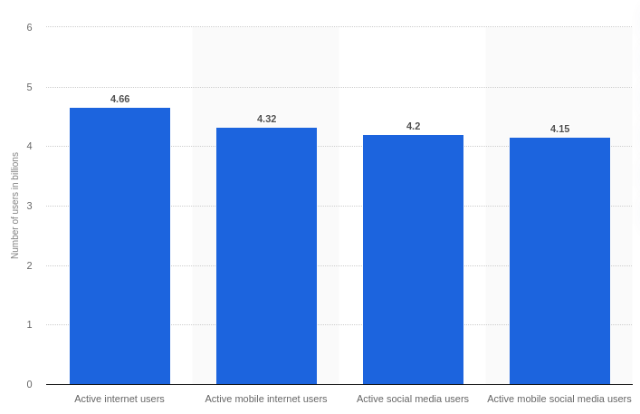
Why New L3 Protocol ?
Limited number of IPv4 address space
Only 4,294,967,296 (2^32) IP addresses
Not enough???
Millions of Laptops, net books and tablets
Millions of Smart Phones (Billions ?) Worldwide Mobile Connections
China 951 M, India 893M
Each electronic device will be a communication node
Owner should be able to communicate with them

Slide 27
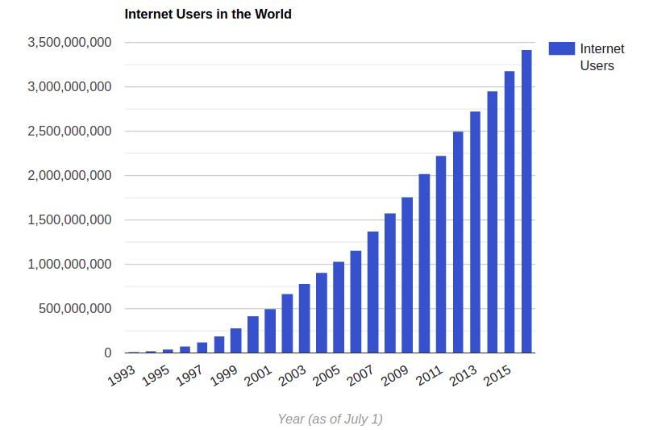

Why Can't Go with IPv4
Growing demand for Internet
More Information : http://www.internetlivestats.com/internet-users/

Slide 28


Why More and More Demand ?
Mobile Communication
Smart Phones
Internet of Things (IoT)
E-services
E-Learning, E-marketing
Pandemic Situation
Work from Home
More IT Enabled businesses

Slide 29
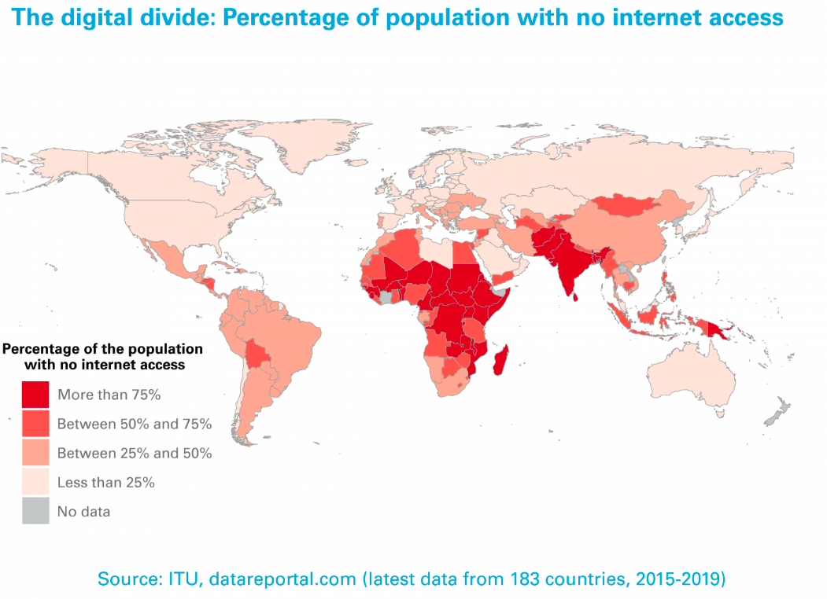
Yet to Come
More Demand is from Developing Countries with high population

Slide 30
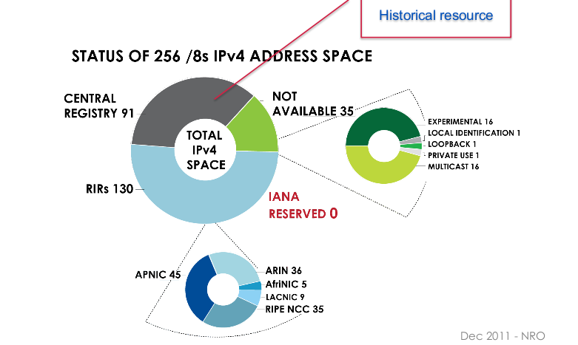
Issues in IPv4 Allocation Policy
IPv4 Allocation before 1990
Internet used for academic and research purposes
Enough IP addresses – Low demand
/8 Networks were Assigned
How many /8 networks are in IPv4?
In /8 sub network, how many hosts
are available?

Slide 31
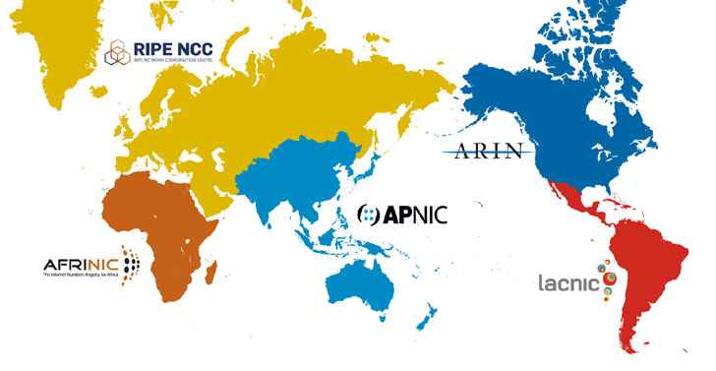
Last IPv4 Allocations
3 February 2011 - primary address pool of the Internet, maintained by IANA, was exhausted.
Last 5 blocks (/8) where allocated to 5 RIRs
15 April 2011 – APNIC exhausted its regional pool (103.0.0.0/8)
Last IPv4 address blocks assigned to Sri Lankan ISP
103.1.176.0/22 – LankaCom
103.29.60.0/22 - SchoolNet
103.2.148.0/22 – Dialog
103.11.32.0/22 - ICTA
103.2.152.0/22 – Mobitel
103.10.172.0/22 – Wavecom
103.247.48.0/22 - Etisalat

Slide 32
Surviving with IPv4
Still Internet can survive with some technical implementations and Features of IPv4
Network Address Translation (NAT) + Private IP address block of Ipv4
NAT allows 'One to Many' address allocations
Private IP ranges
Proxy servers
Allows Web access with private IP addresses
Name based virtual web hosting
Network renumbering to reclaim large blocks of address space allocated

Slide 33
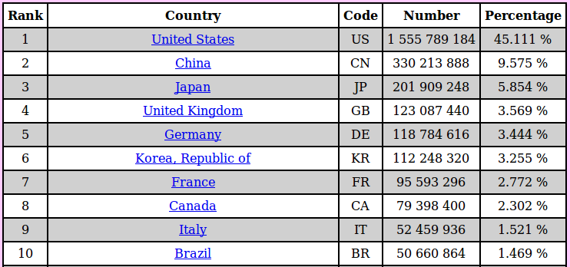
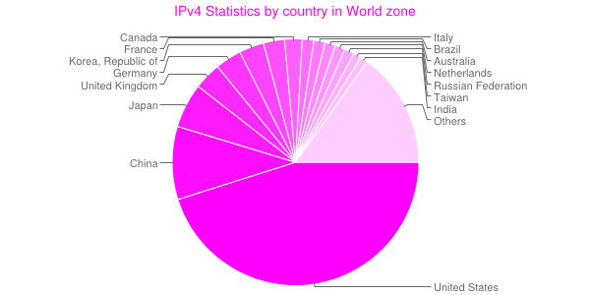
IPv4 Allocation
http://www-public.int-evry.fr/~maigron/RIR_Stats/index.html

Slide 34
IPv4 Private IP ranges
10.0.0.0/8
172.16.0.0/12
192.168.0.0/16
Those are used in many networks but
No route on the Internet
No visibility to outside ( X-forwarded for )
Users still can access web, use skype, provide services to others with NAT, Port forwarding, Proxies

Slide 35
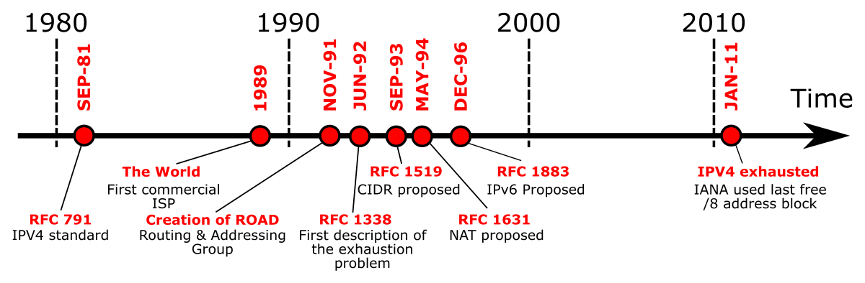
Why Can't go with v4
It is too OLD [RFC 791 September 1981] to cater New Requirements
Mobility
Security
Multi-casting
There were no such requirements when IPv4 was in design stage
Officially published with RFC 791 in September 1981

Slide 36
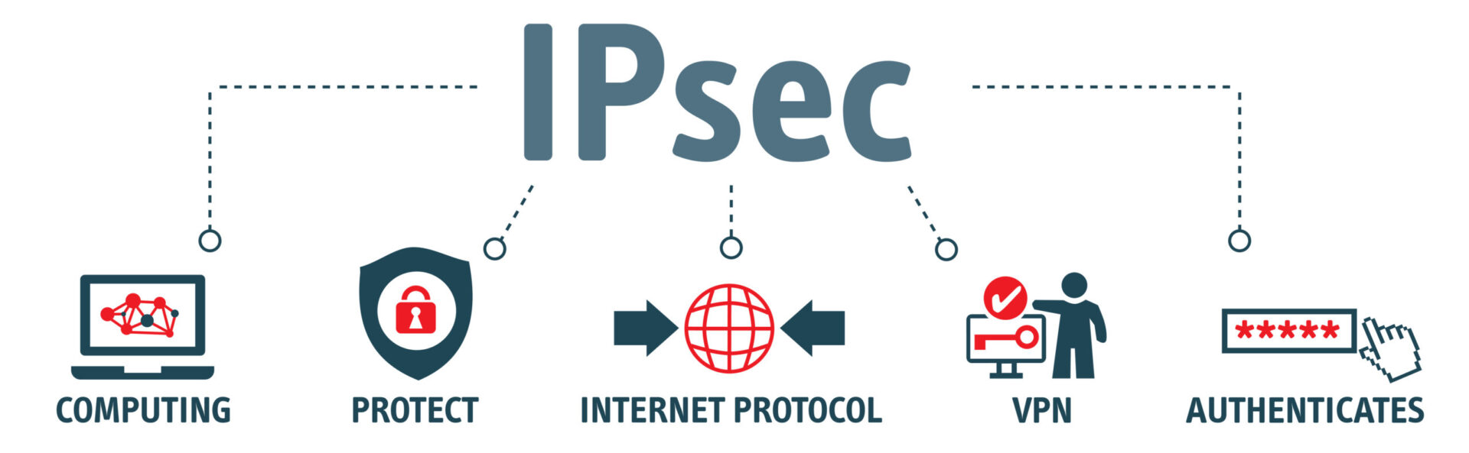
Why Can't Go with V4
Security
Internet Protocol Security (IPSec) provides security for IPv4 packets
Originally defined in RFC 1825 (1995) and RFC 1829 (1998)
New design defined with RFC 4301 (2005)
There were other security implementations at higher layers, But need application layer support
SSL, TLS
Applications did not need to be specifically designed to use IPsec
But..
(IPSec) is NOT built-in and optional
Many IPSec implementations are proprietary

Slide 37
Why Can't Go with IPv4
Issues with NATing
No End-to-end transparency
Network management issues with private address
Routing table issues
High demand for IP address
Always live devices needs real IPs
DSL, ADSL
IANA, was exhausted on 3 February 2011 after releasing last blocks for Ips allocated to 5 RIR
APNIC was the first RIR to exhaust its regional pool on 15 April 2011

Slide 38

New IP Protocol
Design Goals
More Address Space
Routing Efficiency
Support QoS
Built In
Security
Mobility
Extensibility
IETF started working on a new Protocol from 1994
Basic protocol (RFC 2460) - December 1998
Basic socket API (RFC 2553) – 1999
DHCPv6 (RFC 3315) – 2003

Slide 39
IPv6
Developed by the Internet Engineering Task Force (IETF)
Defined in RFC 2460 Dec 1998
IPv5 – Internet Streaming Protocol (1979) was assigned the version 5 by IANA (RFC 1700)
The new version of Internet Protocol received the version number 6 → IPv6

Slide 40
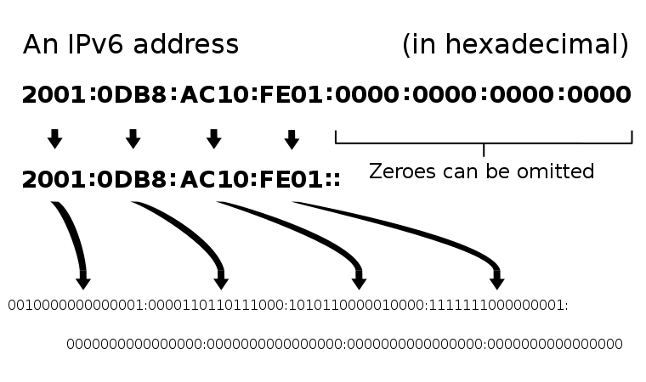
IPv6 Addresses
Uses 128 bits for address
Approximately 3.4x1038 addresses
Approximately 4.8x1028 addresses per person
128 bits long
Usually 64 bits of network, 64 bits for host
Multiple addresses for one host

Slide 41
IPv6 Address Representation
IP Version 6 Addressing Architecture RFC 4291
All addresses are 128 bits
Write as sequence of eight sets of four hex digits (16 bits each) separated by colons
Leading zeros in group may be omitted
Contiguous all-zero groups may be replaced by “::”
Only one such group can be replaced
Notes:
Add privacy addressing

Slide 42







Examples of Writing Addresses
Consider
3ffe:3700:0200:00ff:0000:0000:0000:0001
Omit the leading zeros → 3ffe:3700:0200:00ff:0000:0000:0000:0001
This can be written as 3ffe:3700:200:ff:0:0:0:1
Contiguous all-zero groups may be replaced by “::”
3ffe:3700:200:ff::1
All three reduction methods are used here.

Slide 43
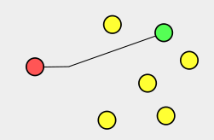
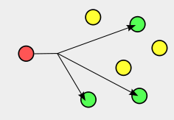
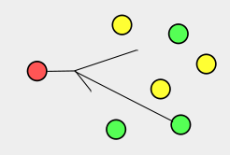
Types of IPv6 Addresses
Like IPv4…
Unicast
packets delivered to the (one) addressed interface
Multicast
Packets delivered to all interfaces with that address
Anycast:
delivered to one (the "nearest“) of the interfaces identified by that address.
Notes:
Anycast is there -- we’ll use it someday. Current usefulness limited to 6to4

Slide 44
What is not in IPv6
Broadcast
There is no broadcast in IPv6.
This functionality is taken over by multicast.
A consequence of this is that the all 0’s and all 1’s addresses are legal.
There are others also we will see later.
Notes:
Want to do discussion about NAT -- bill owens to do a few slides on NAT

Slide 45
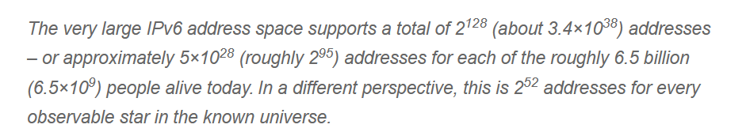
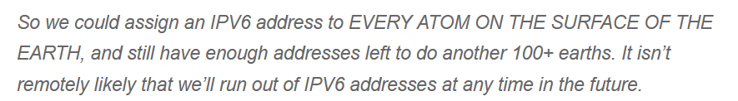
Advancement of IPv6
Number of IP Addresses
2^128 = 2^8 x (2^10)^12 → 265x(1000)^12 →2.56x10³⁸

Slide 46

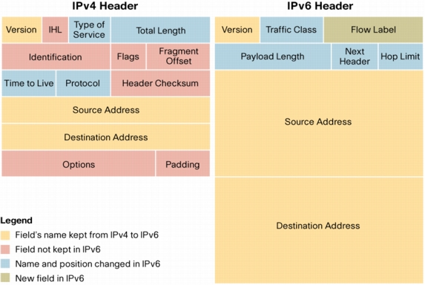
Is that All
IPv6 Provides more Features than the number of Addresses.
Improved the routing speed by Simplifying the IP Header
How?
Fixed length of all fields, not like old options field – IHL, or header length irrelevant
Remove Header Checksum – rely on checksums at other layers
No hop-by-hop fragmentation – fragment offset irrelevant – MTU discovery is mandated
Add extension headers – next header type (sort of a protocol type, or replacement for options)
Basic Principle: Routers along the way should do minimal processing

Slide 47
More Features
Security and Management
End to end transparency
No private IPs
No need of NAT
Easiness in configurations
IP Autoconfigurations – Plug and Play
Supports Mobility and Anycast

Slide 48
IPv6 Subnetting

Slide 49
IPv6 - Subnetting
IPv6 Networks can be subnet to smaller networks easily
Derive small networks by changing the network address part
Subnetting increases flexibility in designing networks, route summarization
IPv6 subnetting works on the same concept as Variable Length Subnet Masking(VLSM) in IPv4.
/32 – Network bits = 32
/48 – Network bits = 48
/50 – Network bits = 50

Slide 50
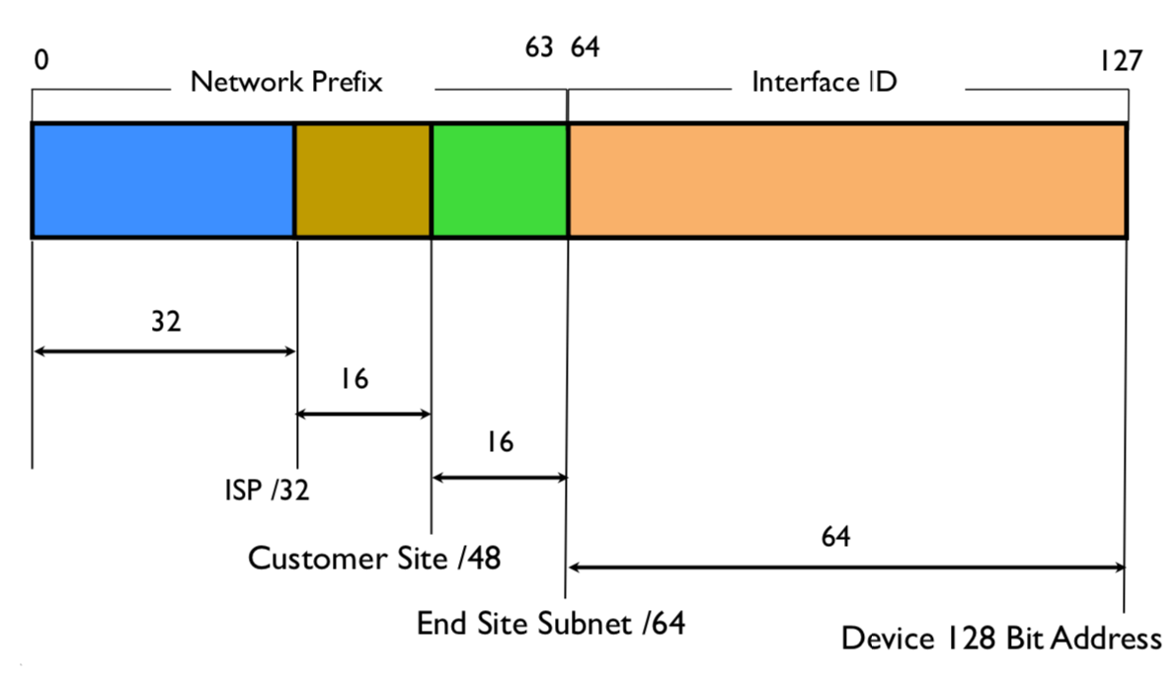
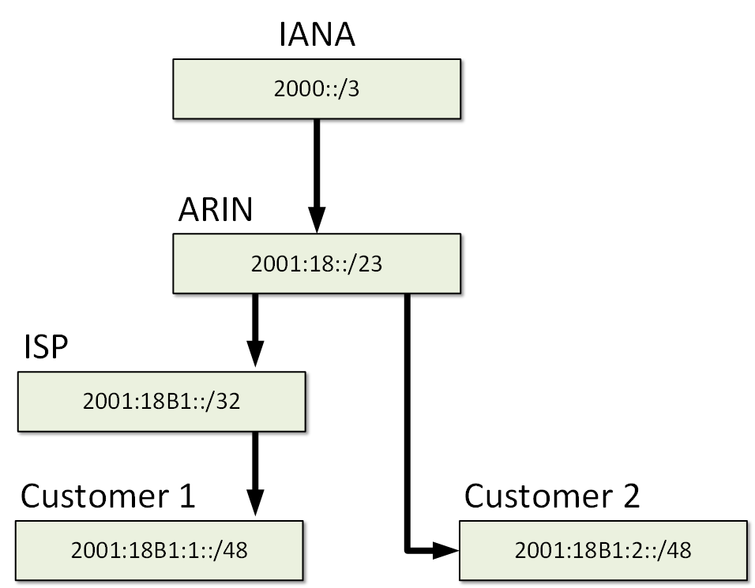
Assignment of IPv6 addresses
Each interface (host) has 1 address
Each network is a /64
Each end site will generally have a /48
64k subnets per site
Regional Internet Registries generally allocate /32 at a time
64k end sites

Slide 51
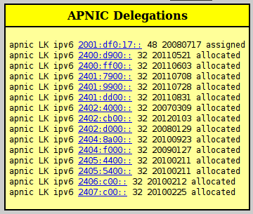
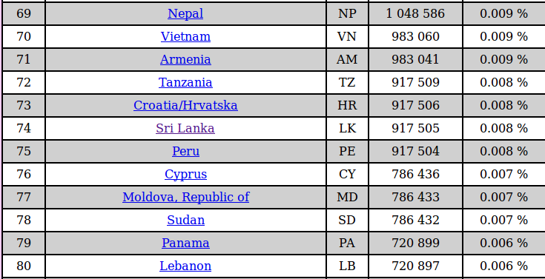
Some Early IPv6 Allocations
Country | Netblock | NetName | Date
CN | 2001:4510::/29 | CGWNET-CNNIC-CN | 20060123
IN | 2001:4520::/32 | HCL-INFINET-IN | 20060131
IN | 2001:4528::/32 | RelianceInfocomm-in | 20060209
NZ | 2001:4530::/32 | MASSEY-IPV6 | 20060216
PK | 2001:4538::/32 | CYBERNET-ipv6 | 20060229

Slide 52
Subnet Mask
Normally depicts as /xx notation
Ex: 2001:17:42::/48
For /64 networks
network bits – 48, subnet bits 16, host bits 64
2^16 different patterns can be generated – over 64,000 /64 subnets
Ex 2001:17:42::/52
Network bits – 52, subnet bits 12, network bits 64
2^12 , /64 subnets can be generated

Slide 53
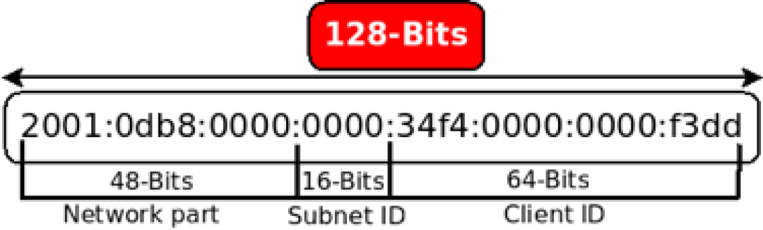
Subnet for IPv6
Similar to IPv4 → /x for the network bits and the remaining for the host bits
Important considerations:
Only /64 is the smallest subnet
Not /124 or /122
When /48 assigned,
The sub networks can be derived from the 48th bit to 64th bit
16 bits are available for subnetting

Slide 54
Example
An organization receives 2402:d000:100c::/48 IP blocks from its ISP.
Assuming the IPv6 address block is assigned to 4 subnets with equal number of hosts, prepare the IP address assignment plan for the 4 subnets. Clearly indicate the network addresses of each subnet.
Methodology
To create 4 subnets from the /48 network, it is required to another 2 bits fixed as 2^2=4
New network bits = 48 + 2 = 50
Subnet can be denoted as /50 network
How to derive the addresses?

Slide 55
How to get the network addresses of each subnet?
2402:d000:100c::/48 divided in to four subnets → 2^2
2 bits needs to be used → 48 + 2 → 50
The subnet is /50
Then How to get each network addresses?
2402:d000:100c: xx00 0000 0000 0000::
From bit 49 to 64
2402:d000:100c:0000 0000 0000 0000::/50 → 2402:d000:100c:0 0 0 0::/50 → 2402:d000:100c::/50
2402:d000:100c:0100 0000 0000 0000::/50 → 2402:d000:100c:4 0 0 0::/50 → 2402:d000:100c:4000:/50
2402:d000:100c:1000 0000 0000 0000::/50 → 2402:d000:100c:8 0 0 0::/50 → 2402:d000:100c:8000:/50
2402:d000:100c:1100 0000 0000 0000::/50 → 2402:d000:100c:C 0 0 0::/50 → 2402:d000:100c:C000:/50

Slide 56
Further subnetting
The last subnet is further sub-netted to /56 subnets.
How many /56 subnets can be derived from that subnet? Clearly indicate the method that you used in finding the answer.
Write the first and the last /56 subnet IP addresses.

Slide 57
Case study
Ex: NSBM IPv6 block is 2401:DF0:17::/48
First 2, /56 blocks will be used for back bone and the next 2, /56 block will be used for the server network
Next 124, /56 for computing faculty, next 64 , /56 for Business and the remaining for Engineering faculty
Prepare the address assignment plan for
Backbone and servers
Eng. Fac/ Computing fac and Business

Slide 58
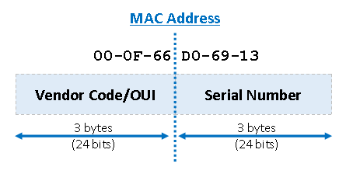
Number of devices which can be manufactured by a vendor
48 bit for a MAC address (The MAC address is unique)
24 bits out of the 48 is a unique number given to the vender
How many different Serial numbers can be derived?
24 bits to be defined the serial number
000000 00000……………………………..1
XXXXXX 000000000000……………….10
XXXXXX 000000000000……………….11
XXXXXX 11111111111111……………11
2^24 = 2^4 x 2^10 x 2^10 → 2^10 = 1024 ~ 1000
2^24 = 16 x 1000 x 1000 → 16 Million devices

